Slide 1
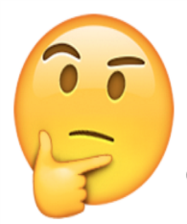
Learning Conversations
This week we have been looking at representing and writing number sentences.
Can you write a number sentence for this representation:
Can you explain the difference between fiction and non-fiction books?
What do we think the weather will be like this weekend? Can you make a prediction?
Notes:
10

