Slide 1
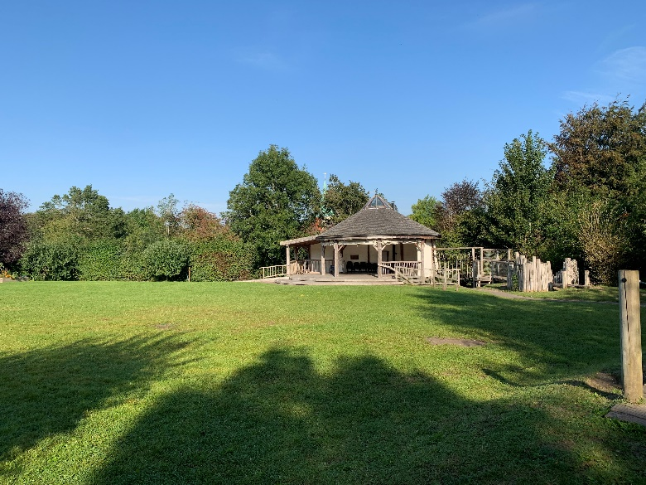
Welcome to Year 1 & 2
Chestnut Class
Show respect
Be determined
Make good choices
Be the best you can be!
Use kind words
Have a go!

Slide 2
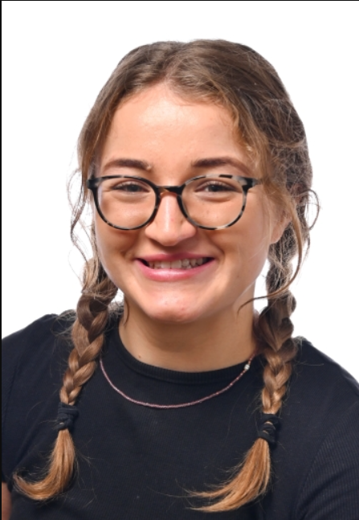
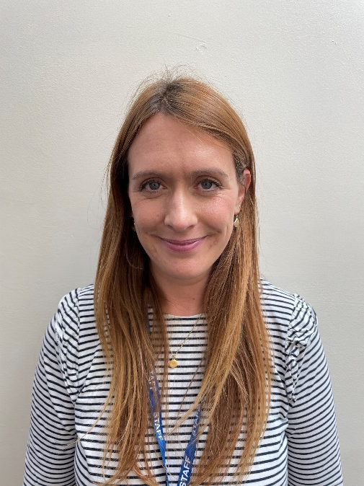
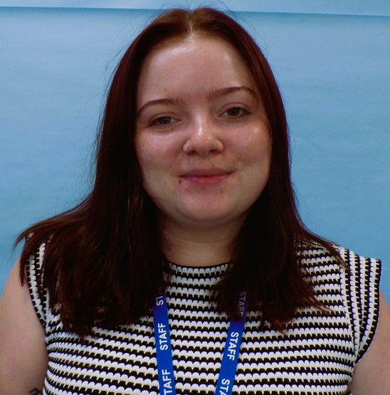
Who are we?
Miss Lloyd
Teacher
Mrs Jones
TA
(Monday-Thursday)
Miss Kirwin
TA
(Mornings only)

Slide 3
Daily Timetable
  8:30- 9: Children begin to come in and do some morning activities as well as complete the register.
  9- 9:15: English carpet time
  9:15- 10:00: Choose & Learn time + Adult group work
  10:00- 10:30: Phonics (Y1) & Spelling (Y2)
  10:30- 10:45: Break
  10:45- 11:00: Snack & Story
  11:00- 11:15: Maths carpet time
  11:15- 12:00: Choose & Learn time + Adult group work
  12:00- 12:45: Lunch
  12:45- 1:15: Story & then topic carpet time
  1:15- 2:20: Choose & Learn time + Adult group work
  2:20- 2:30: Tidy up time
  2:30- 2:45: Carpet time
  2:45-3:00: Break
  3:00- 3:15: Collective Worship/ Assembly
  3:20: Home Time PE Days – Tuesday and Wednesday.- Please wear PE kits

Slide 4
Positive Reinforcement
Raffle Tickets – Demonstrating a school value. 2x children from each class have lunch with an adult in the hall.
House points – Cumulative total in class and then across the school.
Headteacher Award – For exceptional effort/work or sustained effort/achievement (records kept)
Star of the week – 2x children per week for demonstrating the value of the month consistently across the week. (Records kept)

Slide 5
Reading in school
Children will read their books at different points of the week with myself and/or Mrs Jones/Miss Kirwin as well as 2 volunteer readers throughout the week.
Any phonics books with stars on are not completely decodable.
Every child will be read with each week.
Their books will be changed once a week on a Tuesday.
There will also be opportunities for children to go to the library and in addition get a library book.
Daily reading (or as much as possible!) is encouraged at home!

Slide 6

Teaching of Writing
.
At Harting Church of England Primary School we believe that high quality texts should sit at the heart of the teaching of reading and writing. We have carefully selected the Literacy Counts' ‘Ready Steady Write ' program to promote all children's love of reading and writing.
Ready Steady Write is comprehensive and evidence-based. It provides a sequenced, ambitious curriculum, that places quality literature at its core. Each unit has been carefully mapped out to match the entire statutory curriculum for writing.
This approach has and continues to lead to classes full of engaged, enthusiastic and excited children who cannot wait to read and write!

Slide 7


Phonics & Spelling
We continue to follow the Essential Letter and Sounds program that the children started in Reception.
Year 1- Phonics
Year 2- Spelling
For those children who need support with phonics they will receive support through ELS intervention materials.

Slide 8



Maths in school
The Mastery Principles:
Bruner’s three modes of representation – concrete, pictorial, abstract underpin all mathematics from Early Years through to KS2, as does the opportunity to talk maths.
Significant time is spent developing deep knowledge of the key ideas that are needed to underpin future learning. The structure and connections within the mathematics are emphasised, through questioning, representation, practice, problem solving and reasoning, so that pupils develop deep learning that can be sustained
Key facts such as multiples and addition facts within 10 are learnt to automaticity to avoid cognitive overload in the working memory and to enable pupils to focus on new concepts.

Slide 9
Foundation Curriculum
This year our class will be learning about the following:
Knowledge organisers will show what knowledge the children will be learning in each topic and also the skills which they will be developing inline with the national curriculum.
These will also be used to assess the children's understanding and development of these knowledge and skills.
These will be available on the school website for your reference.
Curriculum letter each half term – also on the school website.
Autumn 1 | Autumn 2
Me & my community | Celebrations & Light: Guy Fawkes

Slide 10


Slide 11

Jigsaw, the mindful approach to PSHE/HWB, brings together Personal, Social, Health Education, emotional literacy, social skills and spiritual development in a comprehensive scheme of learning.
Teaching strategies are varied and are mindful of preferred learning styles and the need for differentiation. Jigsaw is designed as a whole school approach, with all year groups working on the same theme (Puzzle) at the same time.
The Six Puzzles (Themes/Units of work)
There are six Puzzles in Jigsaw designed to progress in sequence from the beginning of each academic year:
Term 1: Being Me in My World
Term 2: Celebrating Difference (including anti-bullying)
Term 3: Dreams and Goals
Term 4: Healthy Me
Term 5: Relationships
Term 6: Changing Me (including Sex Education) (Further information will be provided prior to these lessons beign delivered)

Slide 12
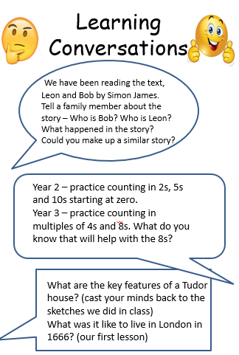
Home learning
Daily reading at home. This could be independent or with an adult. Please record in reading record. .
Learning conversations
Our focus is to continue developing language alongside the children's curiosity for learning.
Each Friday I will upload these to the website. We would like to children and families to think about and discuss these questions with others at home. Sometimes children may do some written or artwork as well as further research, other times it may just be a conversation at home.

Slide 13
Break times
Healthy Eating
Free fruit is provided for children in KS1 to have at break time but your child may want to bring one healthy snack from home.
If you child has packed lunch we ask that they do not consume chocolate or crisps when at school.
Nut Allergies
We have a policy of no nuts on the premises and are a NO NUT school. To safeguard children we ask that nuts are not brought in to school.
Water
Please ensure your child brings in a named bottle of water for use in the classroom.

Slide 14
Communication
School Website – All information, including school news and our school curriculum can be found here
School Website and Class Specific Pages (updated every week with photos and information about that week’s learning)
Make an appointment at the office
First aid – notified of head bumps and more serious injuries by email/phone
minor grazes won’t be shared but a record will be kept.

Slide 15
Share your learning
Be organised
Take pride in your learning
Share your learning
Aim high
Cooperation
Master a new skill
Be kind
Encourage others
Challenge yourself
Ask questions
Care for our environment
Be a good friend
We are looking forward to a fabulous year!
Solve problems
Have a go!
Make good choices
Use your imagination
Be determined
Excellent home learning
Use kind words
Resilience
Take pride
Be curious

Slide 16

Questions?

