Slide 1
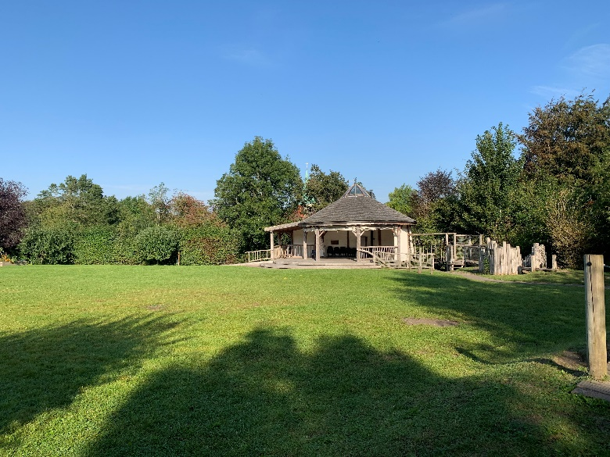
Welcome to Year 1
Willow Class
Show respect
Be determined
Make good choices
Be the best you can be!
Use kind words
Have a go!

Slide 2
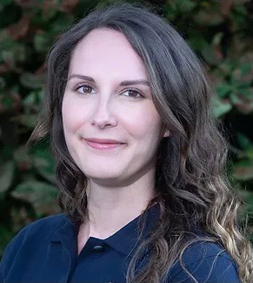
Who are we?
Ms Perry
Teacher
Mrs Forward
Teacher
Miss Sherwood
TA

Slide 3
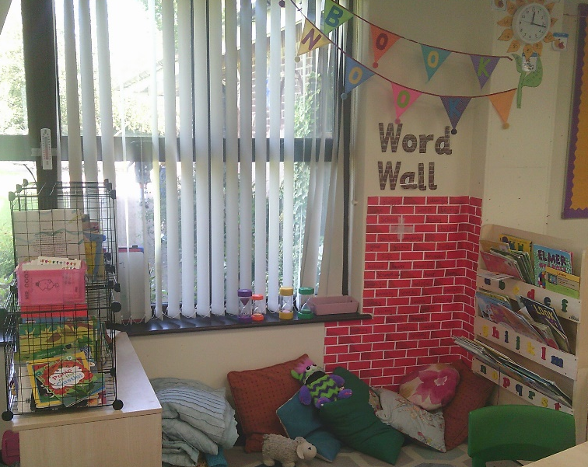
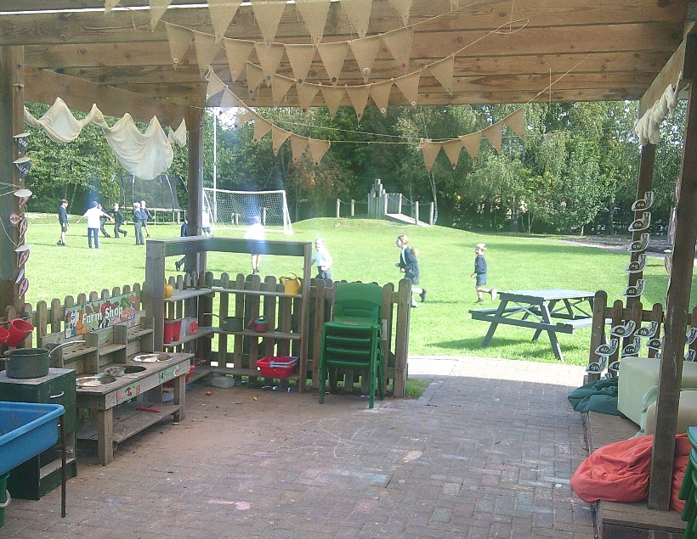
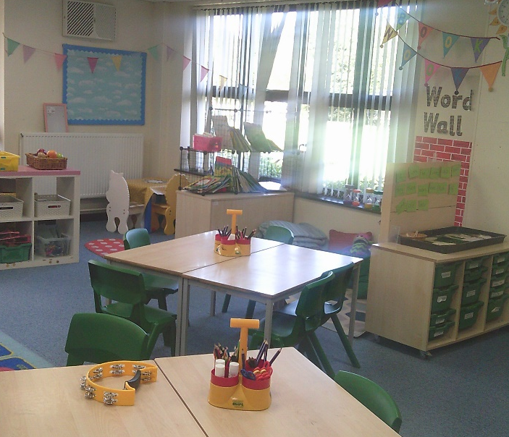
Inside our Classroom

Slide 4
Daily Timetable
8:30- 9: Children begin to come in and do some morning activities as well as complete the register.
9- 9:35: Phonics
9:35- 10:20: English
10:20- 10:30: Snack and a story in the classroom
10:30- 10:50: Break time
10:50- 12:05: Maths
12:05- 1: Lunch
1- 2:30: Topic work
2:30: Collective Worship
3:20- Home Time
PE Days – Tuesday and Wednesday.- Please wear PE kits

Slide 5
Positive Reinforcement
Raffle Tickets – Demonstrating a school value. 2x children from each class have lunch with an adult in the hall.
House points – Cumulative total in class and then across the school.
Headteacher Award – For exceptional effort/work or sustained effort/achievement (records kept)
Star of the week – 2x children per week for demonstrating the value of the month consistently across the week. (Records kept)

Slide 6
Reading in school
Children will read their books at different points of the week with myself or Miss Sherwood. We are also very fortunate to have 2 reading volunteers visit each week.
Every child will be read with each week.
Their books will be changed once a week.
There will also be opportunities for children to go to
the library and in addition get a library book.
Daily reading (or as much as possible!) is encouraged
at home, as is the learning of HRS words

Slide 7
Teaching of Writing
.
At Harting Church of England Primary School we believe that high quality texts should sit at the heart of the teaching of reading and writing. We have carefully selected the Literacy Counts' ‘Ready Steady Write ' program to promote all children's love of reading and writing.
Ready Steady Write is comprehensive and evidence-based. It provides a sequenced, ambitious curriculum, that places quality literature at its core. Each unit has been carefully mapped out to match the entire statutory curriculum for writing.
This approach has and continues to lead to classes full of engaged, enthusiastic and excited children who cannot wait to read and write!

Slide 8
Maths in school
The Mastery Principles:
Bruner’s three modes of representation – concrete, pictorial, abstract underpin all mathematics from Early Years through to KS2, as does the opportunity to talk maths.
Significant time is spent developing deep knowledge of the key ideas that are needed to underpin future learning. The structure and connections within the mathematics are emphasised, through questioning, representation, practice, problem solving and reasoning, so that pupils develop deep learning that can be sustained
Key facts such as multiples and addition facts within 10 are learnt to automaticity to avoid cognitive overload in the working memory and to enable pupils to focus on new concepts.

Slide 9
Foundation Curriculum
This half term our class will be learning about the following:
Geography & Science – Seasons & Weather
Knowledge organisers will show what knowledge the children will be learning in each topic and also the skills which they will be developing in line with the national curriculum.
These will be available on the school website for your reference.
If you would like a paper copy of this please let us know.
Curriculum letter each half term – also on the school website.

Slide 11
Jigsaw, the mindful approach to PSHE/HWB, brings together Personal, Social, Health Education, emotional literacy, social skills and spiritual development in a comprehensive scheme of learning.
Teaching strategies are varied and are mindful of preferred learning styles and the need for differentiation. Jigsaw is designed as a whole school approach, with all year groups working on the same theme (Puzzle) at the same time.
The Six Puzzles (Themes/Units of work)
There are six Puzzles in Jigsaw designed to progress in sequence from the beginning of each academic year:
Term 1: Being Me in My World
Term 2: Celebrating Difference (including anti-bullying)
Term 3: Dreams and Goals
Term 4: Healthy Me
Term 5: Relationships
Term 6: Changing Me (including Sex Education) (Further information will be provided prior to these lessons beign delivered)

Slide 12
Phonics
We continue to follow the Essential Letter and Sounds program that the children started in Reception.
For those children who need support with phonics they will receive support through ELS intervention materials.

Slide 13
Home learning
Daily reading at home. This could be independent or with an adult. Please record in reading record. .
Learning conversations
Our focus is to continue developing language alongside the children's curiosity for learning.
Each Friday we will send home three questions. We would like to children and families to think about and discuss these questions with others at home. Sometimes children may do some written or artwork as well as further research, other times it may just be a conversation at home.

Slide 14
Break times
Healthy Eating
Free fruit is provided for children in KS1 to have at break time but your child may want to bring one healthy snack from home.
If you child has packed lunch we ask that they do not consume chocolate or crisps when at school.
Nut Allergies
We have a policy of no nuts on the premises and are a NO NUT school. To safeguard children we ask that nuts are not brought in to school.
Water
Please ensure your child brings in a named bottle of water for use in the classroom.

Slide 15
Communication
School Newsletter
School Website – All information on our school and the curriculum can be found here.
School Website and Class Specific Pages (updated weekly with photos and information about that week’s learning)
Make an appointment at the office
First aid – notified of first aid administered via slip – if more serious a phone call will be made at the time of the incident.
At pick up and drop off.

Slide 16
Questions?

Slide 17
Share your learning
Be organised
Take pride in your learning
Share your learning
Aim high
Cooperation
Master a new skill
Be kind
Encourage others
Challenge yourself
Ask questions
Care for our environment
Be a good friend
We are looking forward to a fabulous year!
Solve problems
Have a go!
Make good choices
Use your imagination
Be determined
Excellent home learning
Use kind words
Resilience
Take pride
Be curious

